Slide 1
EASE THE COMMUNICATION USING PYTHON

Slide 2
Synopsis
This model could pragmatically help the deaf and hard-of-hearing better communicate using computer vision applications.
This model takes spoken message of a normal person and converts this message to a image of sign language for a deaf-mute person.

Slide 3
CONTENT
INTRODUCTION & IMPORTANCE
LITERATURE SURVEY
DESIGN
IMPLEMENTATION
TESTING AND ANALYSIS
CONCLUSION & FUTURE ENHANCEMENT
REFERENCE

Slide 4
INTRODUCTION & IMPORTANCE
ITS KIND OF DIFFICULT FOR A NORMAL PERSON TO LEARN SIGN LANGUAGE AND COMMUNICATE WITH THEM. HERE PYTHON HELPS US TO FILL THE GAP.
This application takes the speech message of a normal person as input
First the speech message is converted to text using the Google web speech API and this text is converted to image (image from pixels) of sign language .

Slide 5
LITRETURE SURVEY
Sign language is a visual language that is used by deaf people as their mother tongue. Unlike acoustically conveyed sound patterns, sign language uses body language
and manual communication to fluidly convey the thoughts of a person. It is achieved by simultaneously combining hand shapes, orientation and movement of the hands, arms or
body, and facial expressions. It can be used by a person who has difficulties in speaking or by a person who can hear but could not speak and by normal people to communicate with hearing disabled people. As far as a deaf person is concerned, having access to a sign language is very important for their social, emotional and linguistic growth. Sign language should be recognized as the first language of deaf people and their education can be
proceeded bilingually in the national sign language as well as national written or spoken language.
Indian Sign Language is used by deaf and hard of hearing people for communication by showing signs using different parts of body. All around the world there
are different communities of deaf people and thus the language of these communities will be different. The Sign Language used in USA is American Sign Language
(ASL); British Sign Language (BSL) is used in Britain; and Indian Sign Language (ISL) is used in India for expressing thoughts and communicating with each other. The “Indian Sign Language (ISL)” uses manual communication and body language (non-manual communication) to convey thoughts, ideas or feelings. ISL signs can be generally classified
into three classes: One handed, two handed, and non-manual signs. One handed signs and two handed signs are also called manual signs where the signer uses his/her hands to
make the signs for conveying the information. Non Manual signs are generated by changing the body posture and facial expressions. This system is to help hearing impaired
people in India interact with others as it translates English text to Sign language
https://www.geeksforgeeks.org/project-idea-audio-sign-language-translator/

Slide 6
IMPLEMENTATION
We are using following libraries
Pandas
Numpy
Matplotlib
Speech Recognition
We are using pandas for importing and manipulation with the dataset.
We are using numpy for arrays.
We are using matplotlib for plotting the images.
We are using speech recognition for audio.
We have used python language for the implementation part and
used anaconda spyder IDE.

Slide 7
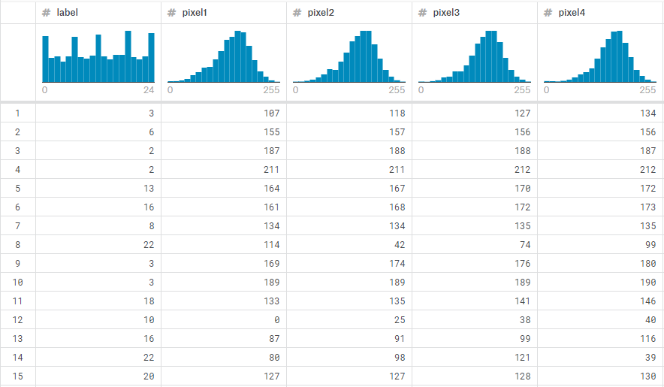
A sneak pick of the dataset

Slide 8
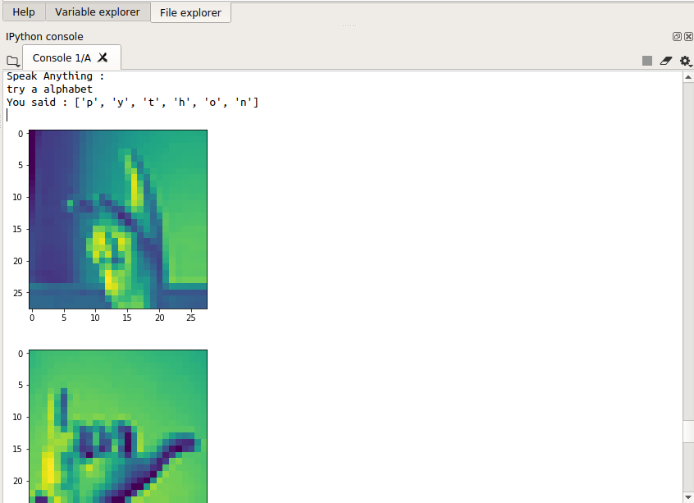
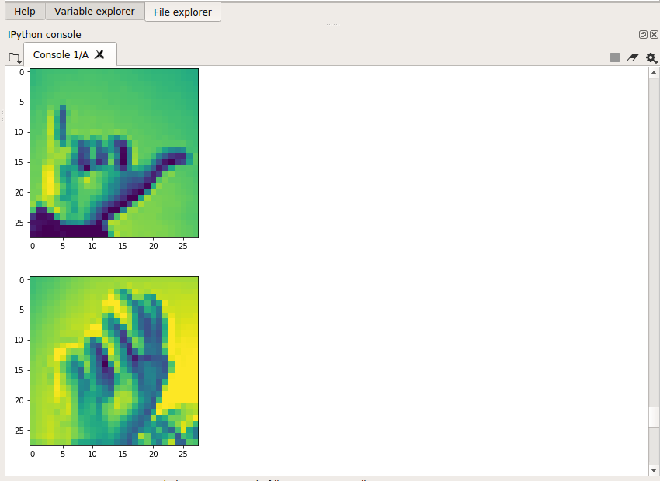
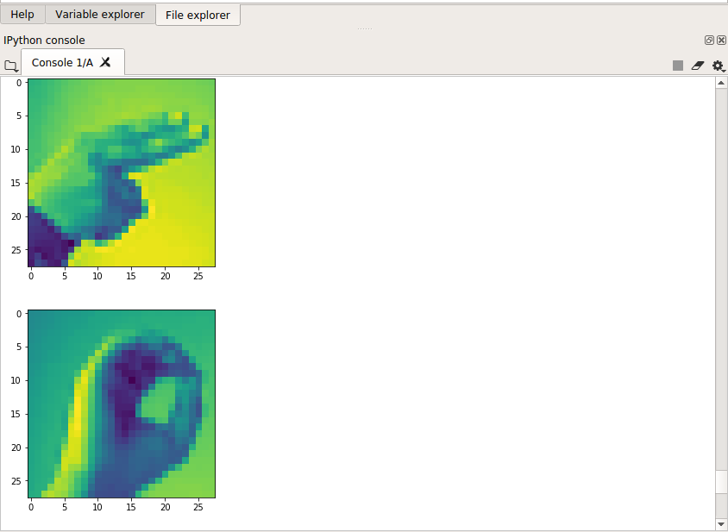
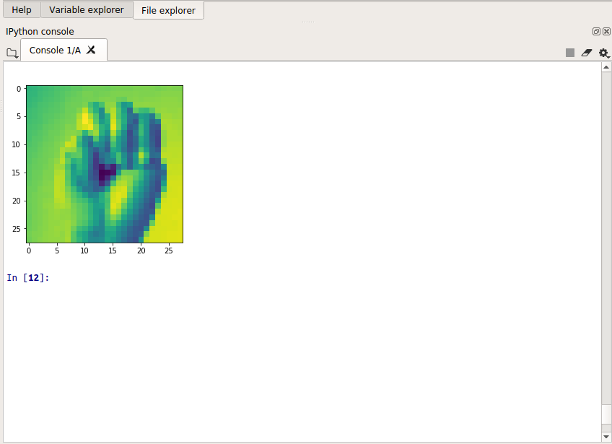
TESTING
We said python
It will print the signs for the “python”

Slide 9
CONCLUSION AND FUTURE ENHANCEMENT
At last I would like to conclude by saying that everything is possible with the help of technology.
In the future, the model can have more improvement and features like a animation or a full sentence with animation. This would be more helpful and easy to interpret.
Initially it is compatible with English but in future we are expecting to add more languages.
Initially the image is a 2D image but in future we can have an animated conversion of the a sign language phrases.
Currently the model is throwing the sign for each individual alphabet but in future we can have sign for a full word or a sentence.

Slide 10
REFERENCEs
For dataset we referred the following
https://www.kaggle.com/datamunge/sign-language-mnist
https://realpython.com/
https://towardsdatascience.com/?source=post_page-----bfb34250036e----------------------
https://www.analyticsvidhya.com/myfeed/?utm-source=blog&utm-medium=top-icon%2F
https://www.analyticsvidhya.com/blog/2019/08/3-techniques-extract-features-from-image-data-machine-learning-python/

Slide 11
THANK YOU

